Slide 1
Fashion Image Classification Using Convolutional Neural Networks (CNNs)
Raagini Tyagi, Yuming Huang, Ece Yildiz, Shitao Zhao

Slide 2
Introduction
Implemented and evaluated CNN-based models (ResNet18, EfficientNetB0) for fashion image classification.
Performed multi-class classification to categorize fashion items into broad categories (such as Apparel, Footwear, Accessories, etc.) with high accuracy, improving the overall product categorization process.

Slide 3
Motivation
The fashion industry relies on efficient product categorization for inventory management and e-commerce.
E-commerce platforms need accurate and efficient product categorization for better search, filtering, and personalized recommendations.
Manual classification is time-consuming/inefficient, error-prone, and inconsistent.
Automating classification using deep learning increases accuracy, reduces human error and operational costs, and improves search functionality and user experience.

Slide 4
Machine Learning Models Used
Convolutional Neural Networks (CNNs):
Used to extract visual features and patterns from fashion product images.
ResNet18:
Uses residual learning to train deep networks efficiently without vanishing gradients.
EfficientNetB0:
Uses compound scaling to balance network depth, width, and resolution for optimal performance

Slide 5
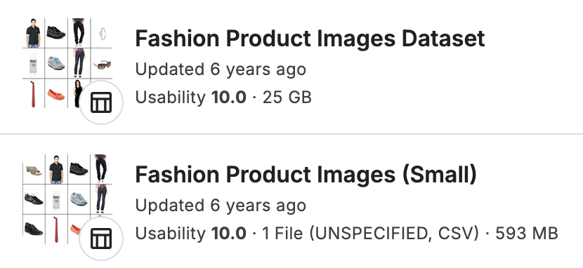
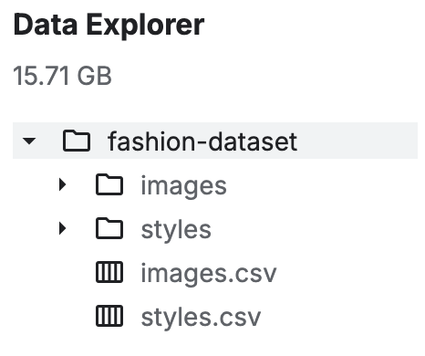
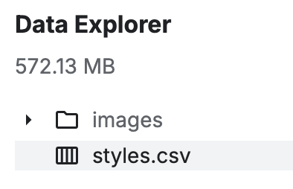
Dataset
Fashion Product Images Dataset:
https://www.kaggle.com/datasets/paramaggarwal/fashion-product-images-dataset
Fashion Product Images Dataset (Small):
https://www.kaggle.com/datasets/paramaggarwal/fashion-product-images-small
44,000 products with multiple category labels, descriptions and images

Slide 6
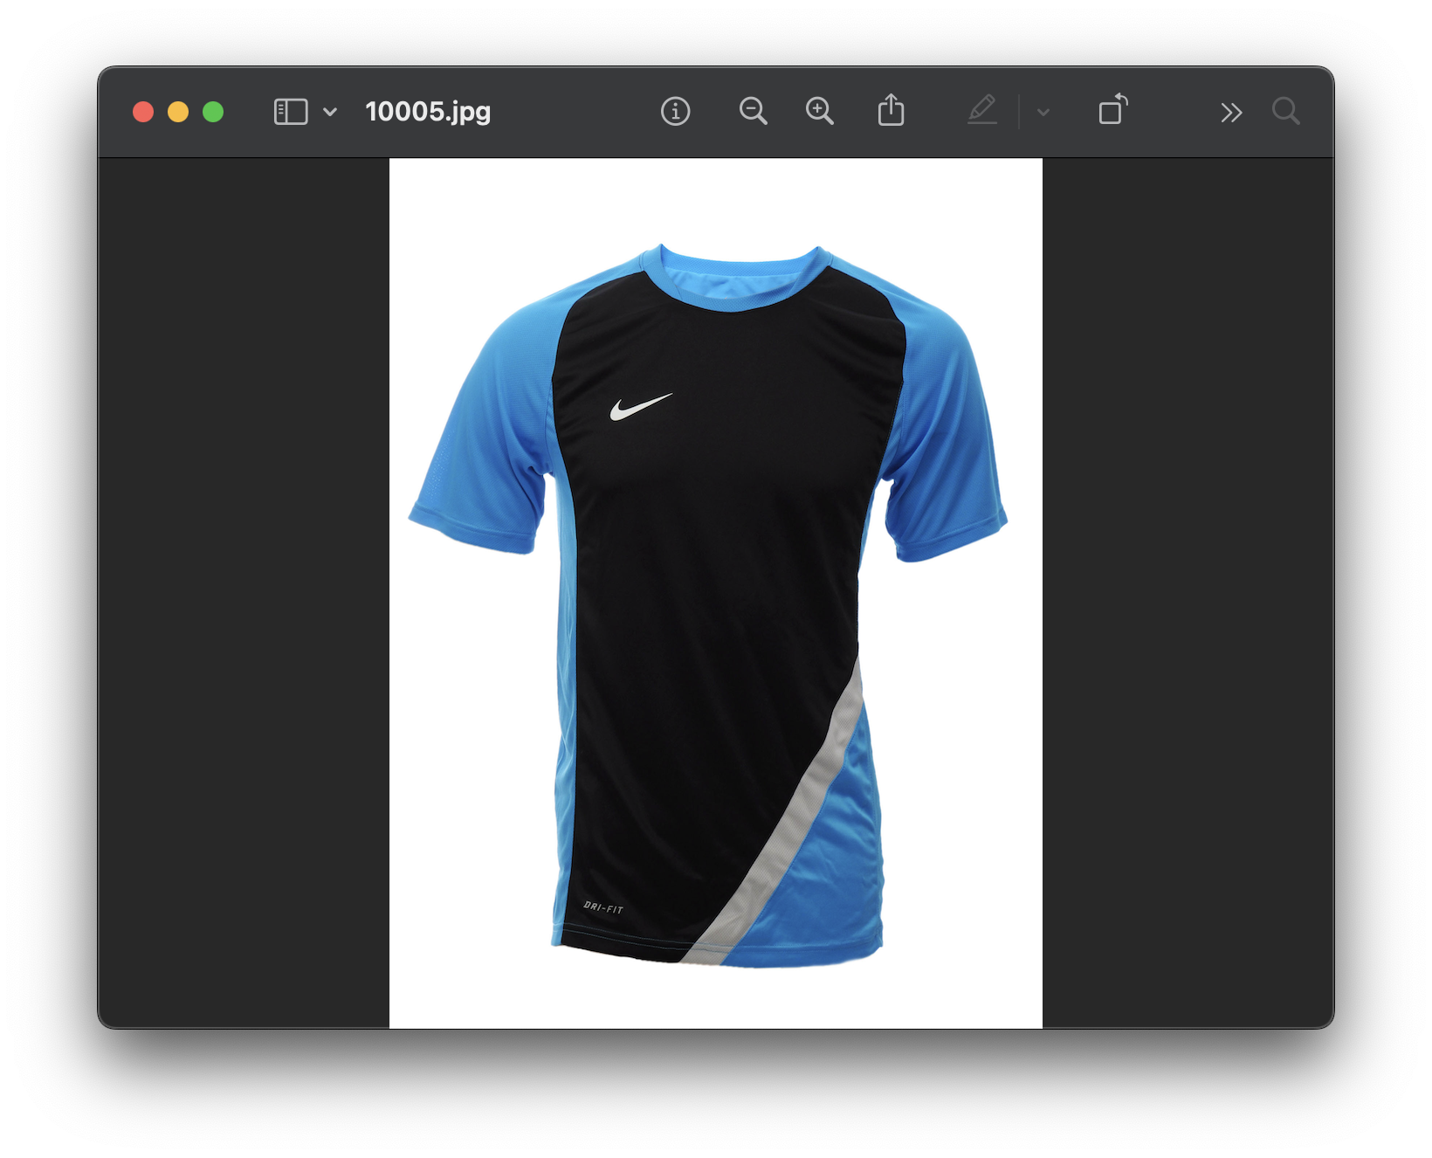
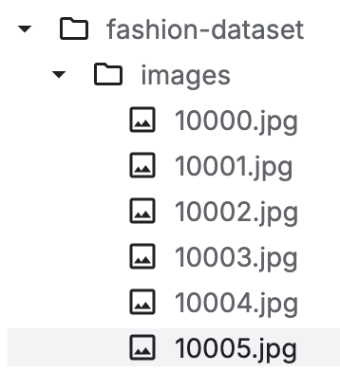
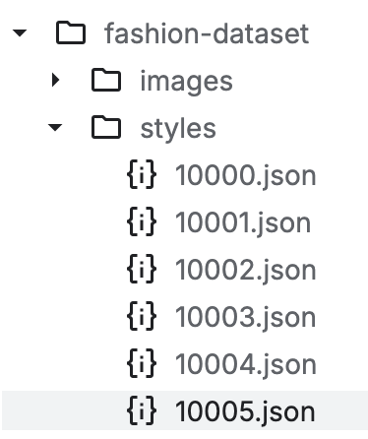

Dataset (Continued)

Slide 7
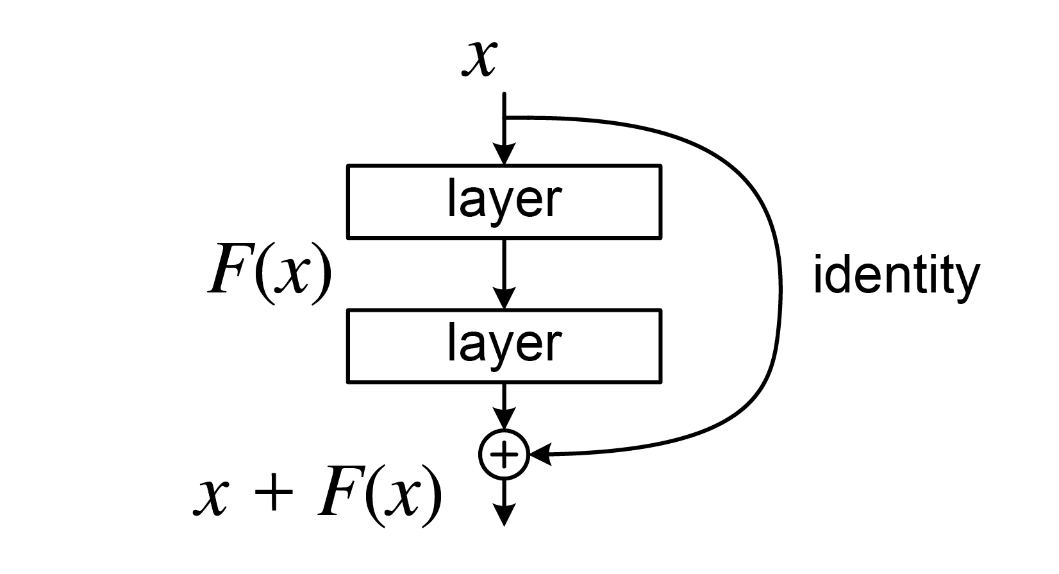
Resnet
Easy to train even when deep.
Good baseline performance on image classification tasks.
Robust and widely adopted.
Solves the vanishing gradient problem.
Uses skip connections to let gradients flow across layers.

Slide 8
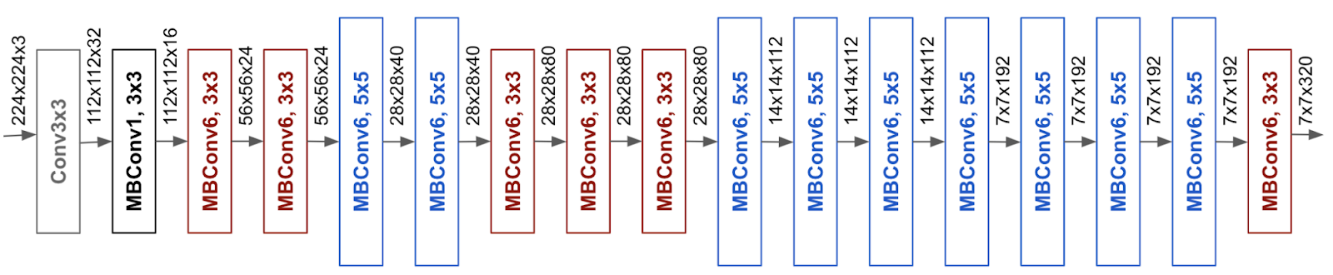
EfficientNet
State-of-the-art performance with less computation.
Adapts well to different hardware and application needs.
Works great for fine-grained tasks like fashion classification.

Slide 9


Accuracy and Metrics (Resnet) Smaller Dataset
Accuracy and Metrics (Efficient Net)
The data set was highly skewed
F1 -Score is used: 77.66%
Accuracy for Small Dataset:
Similar results with Resnet
Slightly lower around 77.63%

Slide 10


Accuracy and Metrics (Resnet) Larger Dataset
Accuracy and Metrics (Efficient Net)
The data set was highly skewed
F1 -Score is used: 79%
Accuracy for Large Dataset:
F1 Score: 82%

Slide 11
Thank You!

